Slide 1
MRI-Based Brain Tumor Segmentation
By:
Dmitrii Kornienko Svetlana Lukina
Maksim Elistratov
Ivan Valuev

Slide 2
Relevance
Need for precise neuro-pathology delineation
Post-analysis
Supporting adaptive treatment planning
Automated segmentation of brain cancer lesions provides pixel-level accuracy
Segmentation enables precise volume measurements of lesions, essential for monitoring disease progression or therapy response.
Rapid, reliable identification of pathology boundaries informs surgical navigation, radiotherapy targeting, and real-time intervention strategies

Slide 3
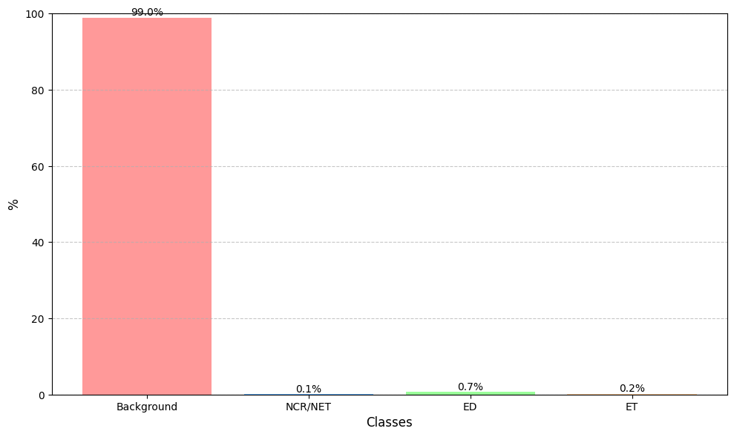
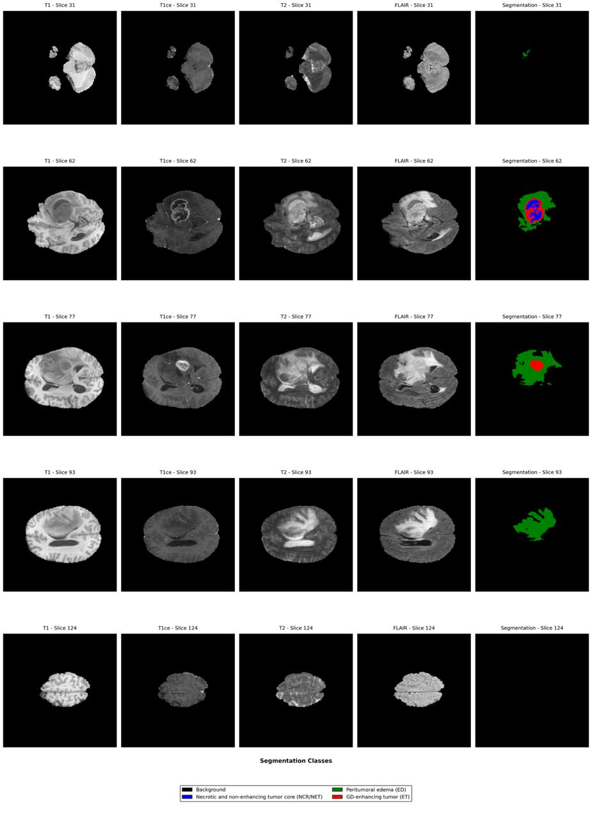
Dataset structure
Dataset Structure (Per Case): Each patient case includes 4 imaging modalities and 1 segmentation label:
t1.nii – T1-weighted MRI
t1ce.nii – T1 with contrast enhancement
t2.nii – T2-weighted MRI
flair.nii – FLAIR modality
seg.nii – Ground truth segmentation mask
Modalities are different types of MRI scans, each providing unique information about brain tissue. They are passed to the model as input channels:
FLAIR – highlights edema
T1CE – shows contrast-enhancing tumor regions
T1 – provides anatomical context
T2 – captures fluid and lesion spread
Input/Output Shapes:
Input: 4 × H × W (modalities as channels)
Output: 4 × H × W (one-hot encoded segmentation for 4 classes)

Slide 4
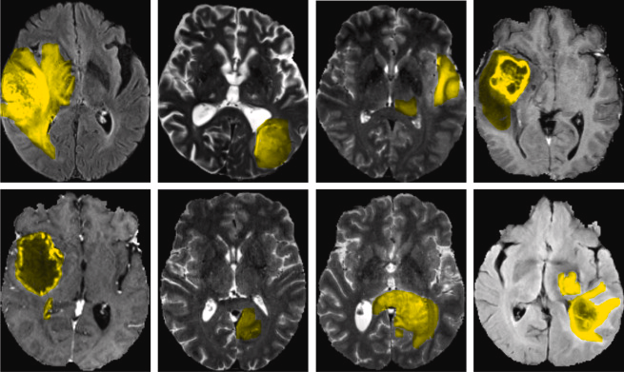
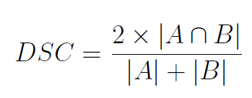
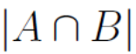
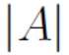
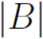
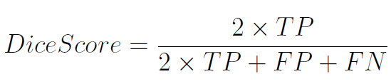
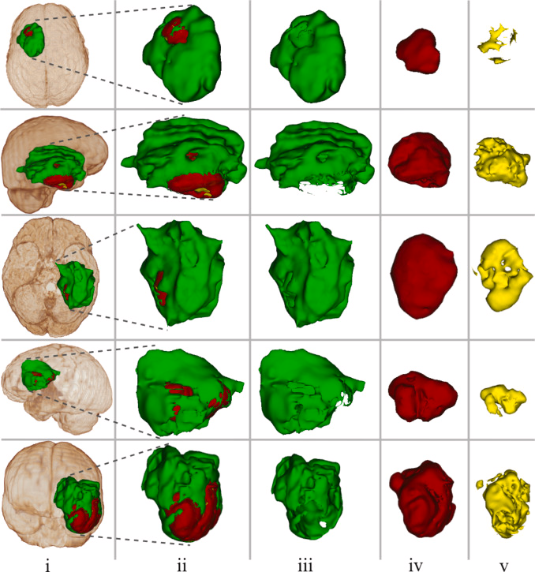
METRICS
A - predicted mask, B - groundtrue mask,
the number of pixels in the intersection
the total number of pixels in each mask
TP — True Positives, FP — False Positives, FN — False Negatives.
(i) Location of the tumor in the brain, (ii) Whole brain tumor (WT), (iii) Edema around the tumor (PE), (iv) Tumor enhancement (ET), and (v) Tumor core (TC)
Dice WT: Measures overlap for the entire tumor (labels 1, 2, 4 combined).
Dice TC: Measures overlap for the tumor core (labels 1, 4 combined).
Dice ET: Measures overlap for the enhancing tumor (label 4 only).

Slide 5
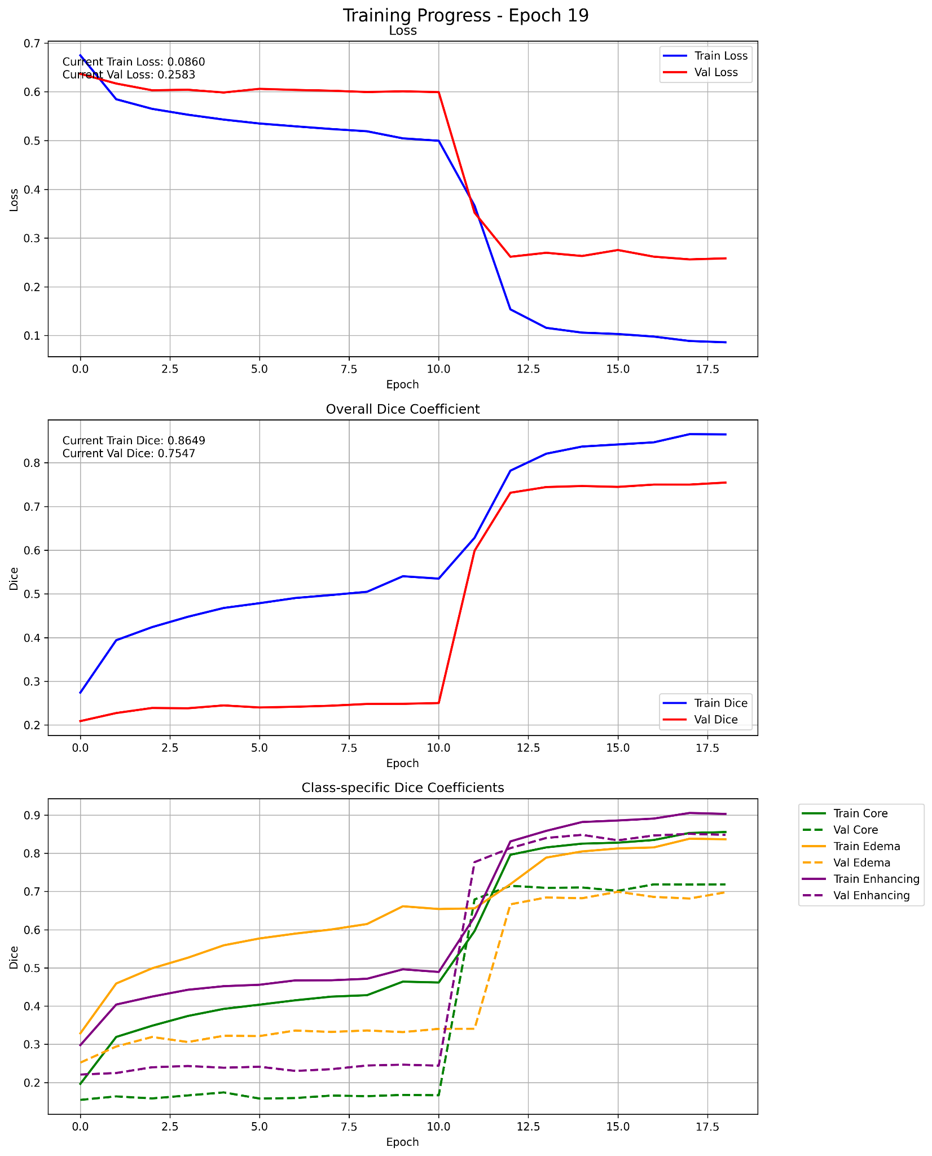
2D UNet
Model: 2D U-Net
Spatial Dimensions: 2D.
Output Channels: 4.
Input Channels: 4 (T1, T1ce, T2,FLAIR)
Output Channels: 4 (Segmentation classes: Background, NCR-NET, ED, ET)
Feature Channels: [64, 128, 256, 512, 1024] (encoder) & [512, 256, 128, 64] (decoder)
Downsampling via MaxPool, upsampling via ConvTranspose2d
Each block uses Conv2d → BatchNorm → ReLU ×2
Data preprocessing:
Middle slice calculation: volume_slices // 2
Range: middle_slice ± (slices_per_volume // 2)
Slices per volume: 16 (slices_per_volume)
Loss Function:
Categorical Dice Loss = CrossEntropy + Dice Loss
One-hot encoded targets used for Dice computation
Training Setup:
Optimizer: Adam, LR = 5e-5
Warmup Scheduler: LinearLR for 5 epochs
Main Scheduler: ReduceLROnPlateau
Evaluation Metrics:
Mean Dice Coefficient across all classes
Per-class Dice scores (NCR-NET, ED, ET)
Combined loss (CE + Dice)

Slide 6
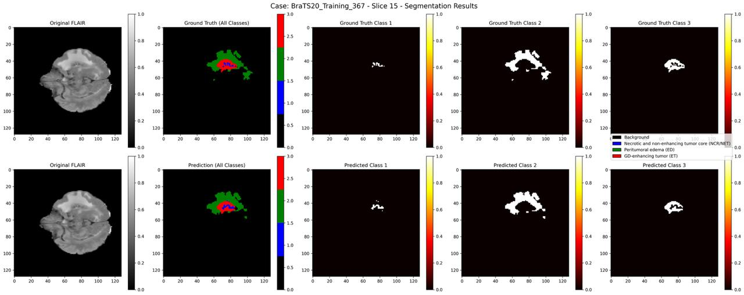
2D UNet Segmentation Results

Slide 7
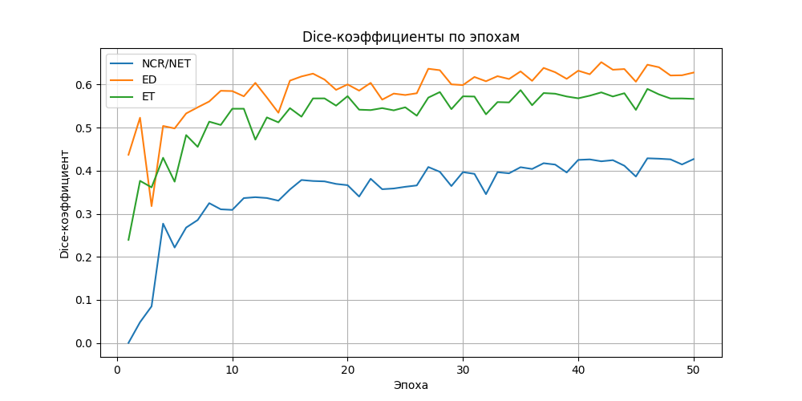
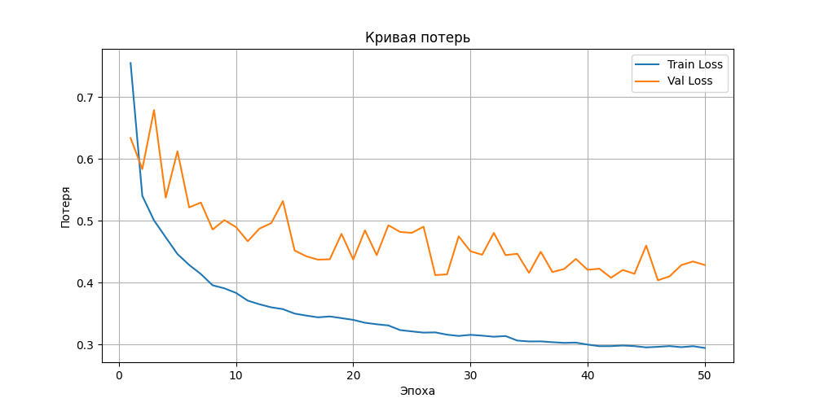
3D UNet (common)
Model: 3D U-Net
Spatial Dimensions: 3D.
Input Channels: 4.
Output Channels: 4.
Feature Channels: (64, 128, 256, 512).
Strides: (2, 2, 2).
Residual Blocks: 2.
Dropout Rate: 0.6.
Loss Function:
Categorical Dice Loss = CrossEntropy + Dice Loss
One-hot encoded targets used for Dice computation
Training Setup:
Optimizer: Adam, LR=1e-4
LR Scheduler: ReduceLROnPlateau
Early Stopping: patience=5 epochs
Evaluation metric: Mean Dice Coefficient

Slide 8
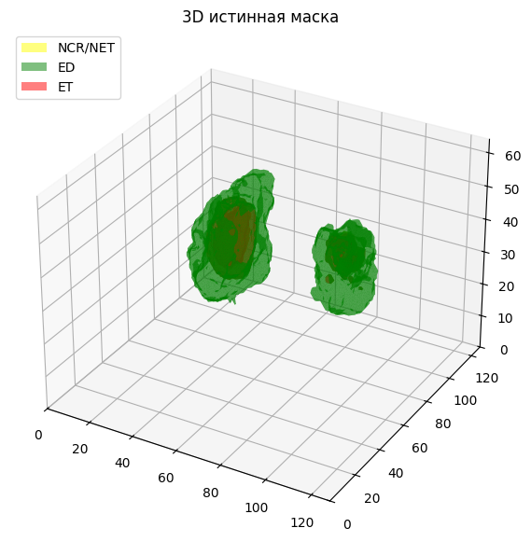
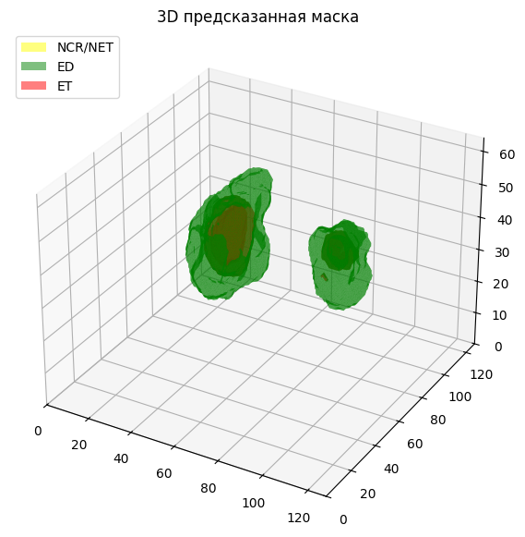
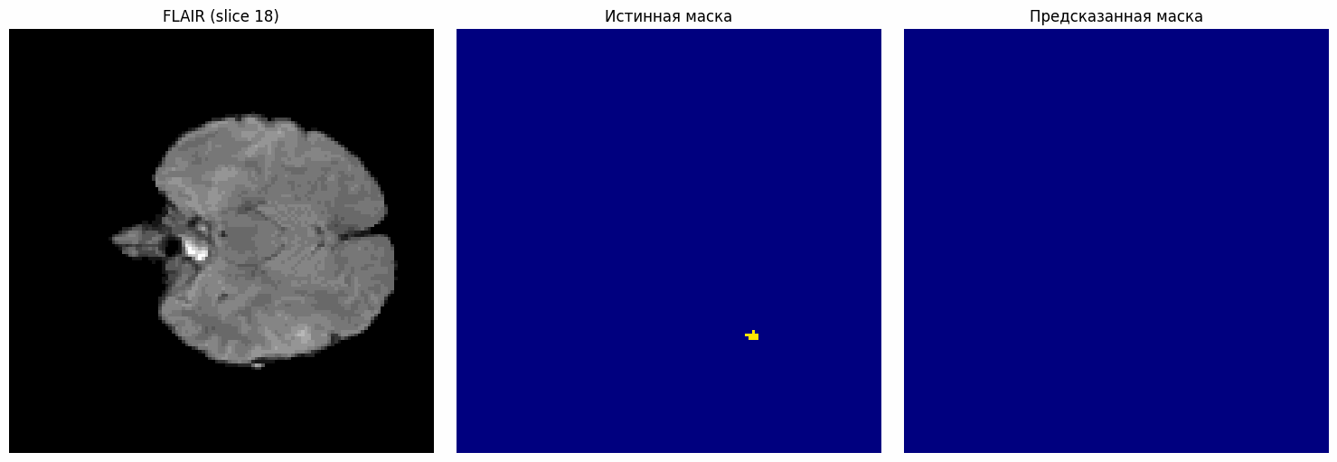
3D UNet (common)

Slide 9
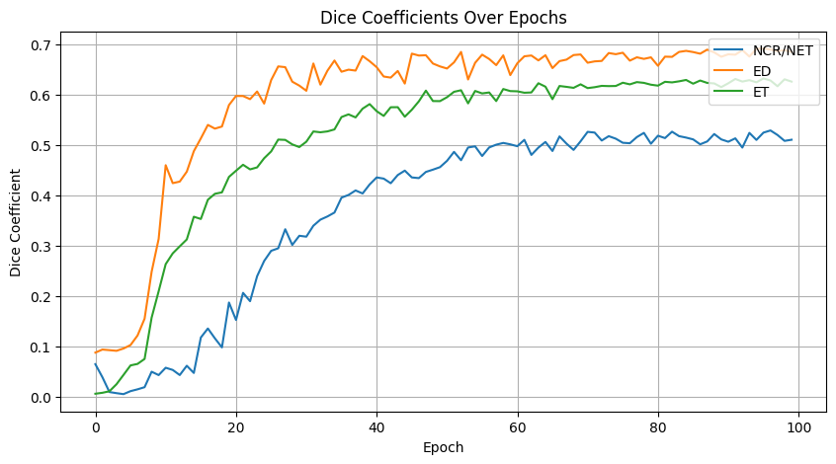
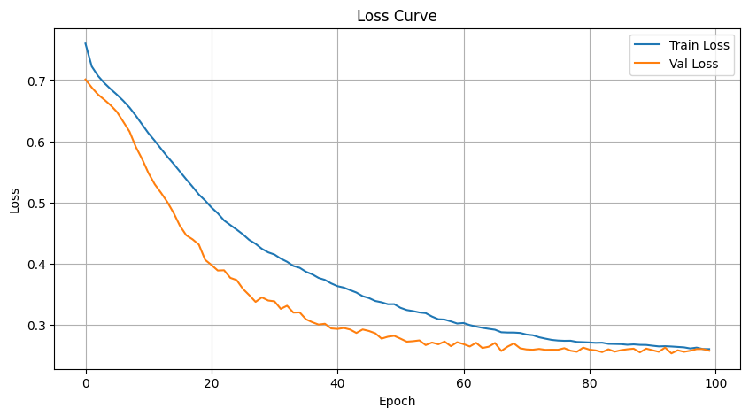
3D UNet (enhanced)
Model: 3D U-Net
Spatial Dimensions: 3D.
Input Channels: 4.
Output Channels: 4.
Feature Channels: (128, 256, 512, 1024).
Strides: (2, 2, 2).
Residual Blocks: 4.
Dropout Rate: 0.9.
Loss Function:
Categorical Dice Loss = CrossEntropy + Dice Loss
One-hot encoded targets used for Dice computation
Training Setup:
Optimizer: Adam, LR=1e-4
LR Scheduler: ReduceLROnPlateau
Early Stopping: patience=10 epochs
Evaluation metric: Mean Dice Coefficient

Slide 10
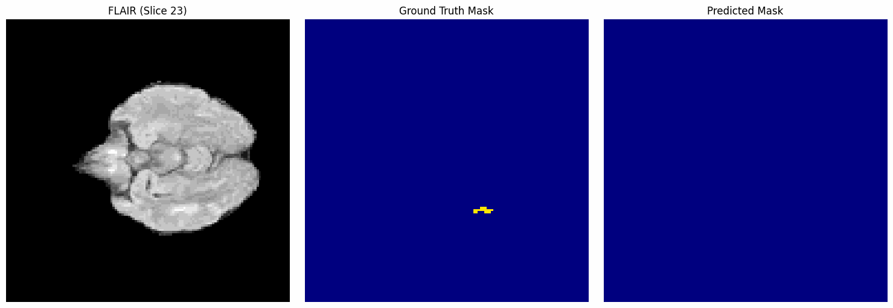
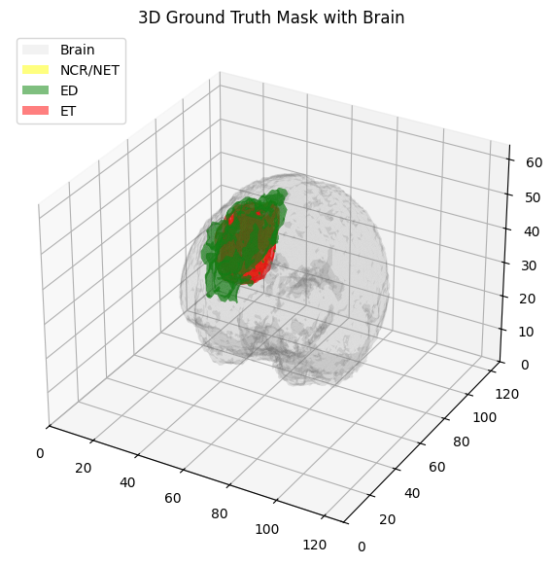
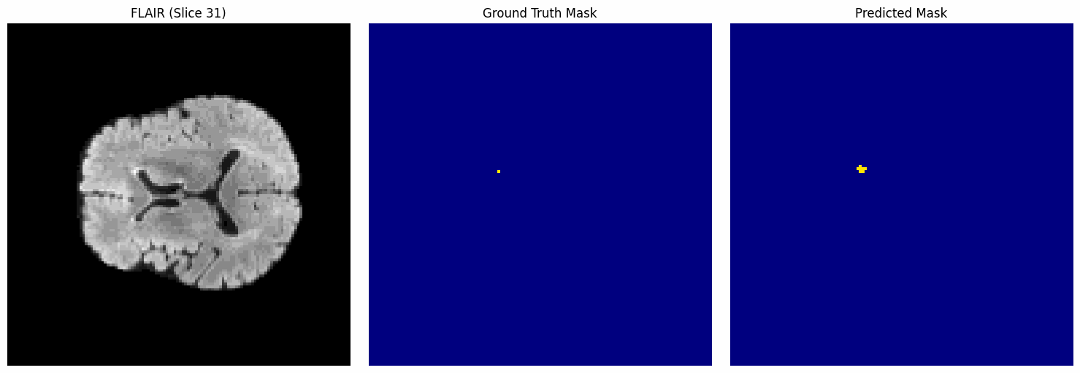
3D UNet (enhanced)

Slide 11
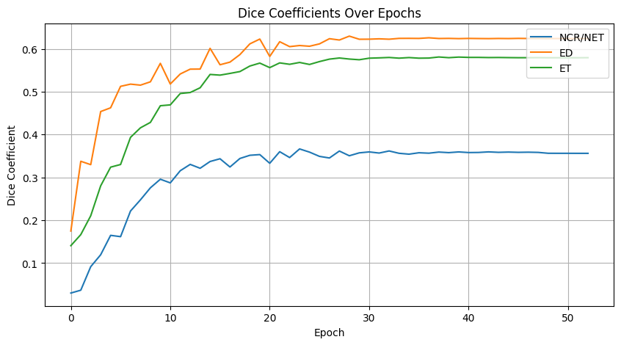
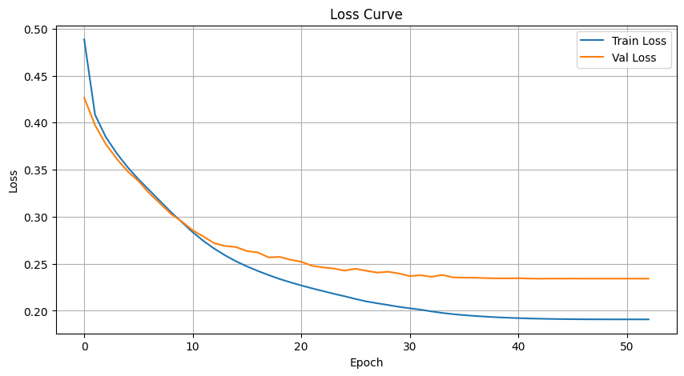
SwinUNETR
Model: 3D U-Net
Input Resolution: (96, 96, 32).
Input Channels: 4.
Output Channels: 4.
Feature Dimension: 48.
Dropout Rates: 0.0 (standard, attention, path).
Checkpoint Usage: Disabled (False).
Loss Function:
Categorical Dice Loss = CrossEntropy + Dice Loss
One-hot encoded targets used for Dice computation
Training Setup:
Optimizer: Adam, LR=1e-4
LR Scheduler: ReduceLROnPlateau
Early Stopping: patience=10 epochs
Evaluation metric: Mean Dice Coefficient

Slide 12
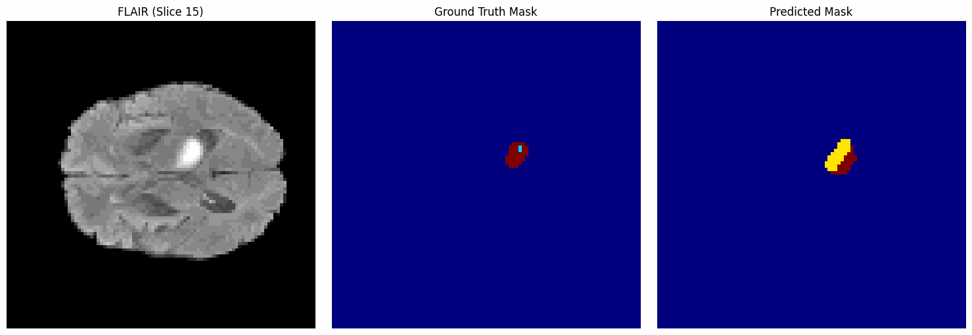
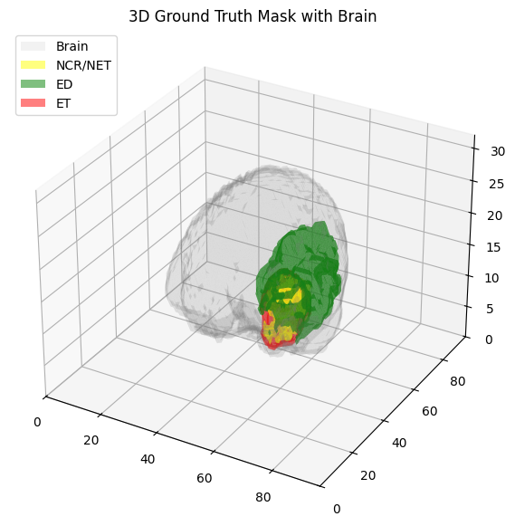
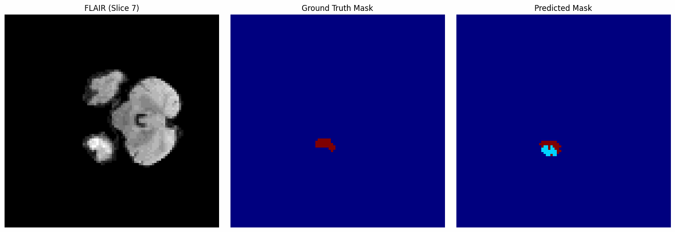
SwinUNETR

Slide 13
SAM / MedSAM / SAM-Med3D
Segment Anything Model (SAM) is a general-purpose image segmentation model that can extract objects from images without additional training.
Architecture: an image encoder, a hint encoder, and a mask decoder.
MedSAM
SAM-Med3D
MedSAM is an adaptation of SAM for medical image segmentation.
The model was trained on a large medical dataset of over 1.5 million image and mask pairs, covering 10 different modalities and over 30 cancer types.
SAM-Med3D extends SAM to 3D medical images.
The model was trained on the large 3D medical dataset SA-Med3D-140K, which includes 22,000 3D images and 143,000 corresponding masks.

Slide 14

Why we didn't use SAM / MedSAM / SAM-Med3D
In short: Data preparation requires massive processing and rigorous modification of the structure.
Remind our dataset structure:
4 MRI modalities: flair, t1, t1ce, t2
1 multi-class segmentation mask (0 — background, 1-3 — tumor classes)
Dimensionality: (C=4, D=240, H=240, W=155)
Model | Required input | Comment
SAM (2D) | RGB image + bounding box | It is necessary to manually or automatically mark the bbox for each slice
MedSAM (2D) | (H, W, 3) RGB + mask to PNG | Requires 3D modal conversion to 2D RGB, normalization and resizing to 1024x1024, and mask conversion
SAM-Med3D | 3D tomograms format (1, D, H, W) | Requires a single-channel image and a binary mask - not directly suitable for multi-class segmentation

Slide 15
Thanks for listening!

